Slide 1
Paw Net
“The application to find your one true pet”

Slide 2
Team Members
Akshit Anand
Ankit Trehan
Billy Roveran
Ritik Ghanshani

Slide 3
Introducing PawNet
Swipe styled application
Connects the adopter and adoptee directly
Chat service
Ease of navigation throughout application

Slide 4


Development Environment
Flutter
Firebase
Firestore
Android

Slide 5
Tools
Trello
Slack
Skype
Git
Android Studio / Visual Studio Code

Slide 6
Experiences and Lessons
Dart was interesting
Emulators
Time constraints
Firebase/Firestore

Slide 7
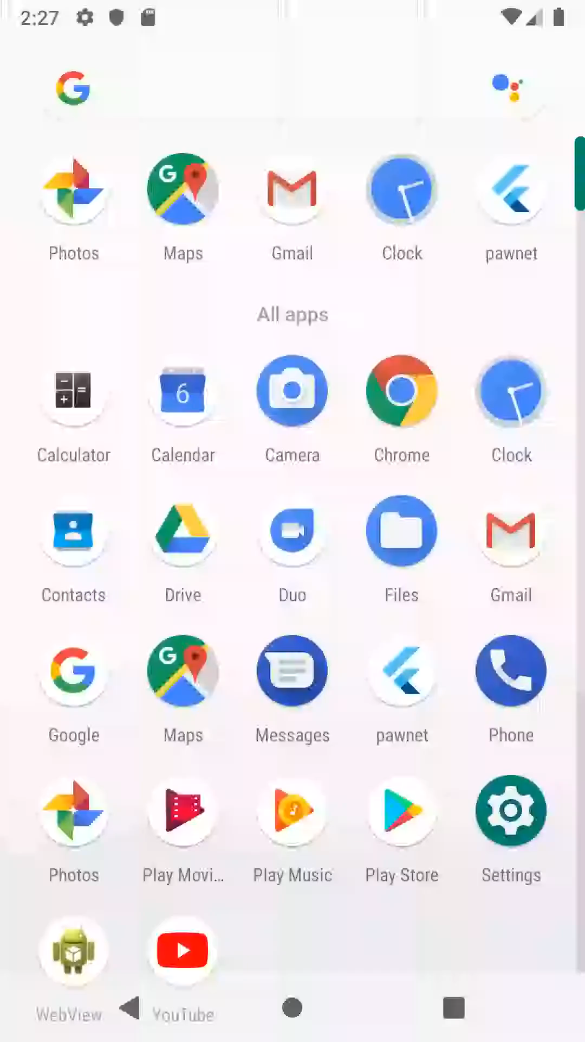
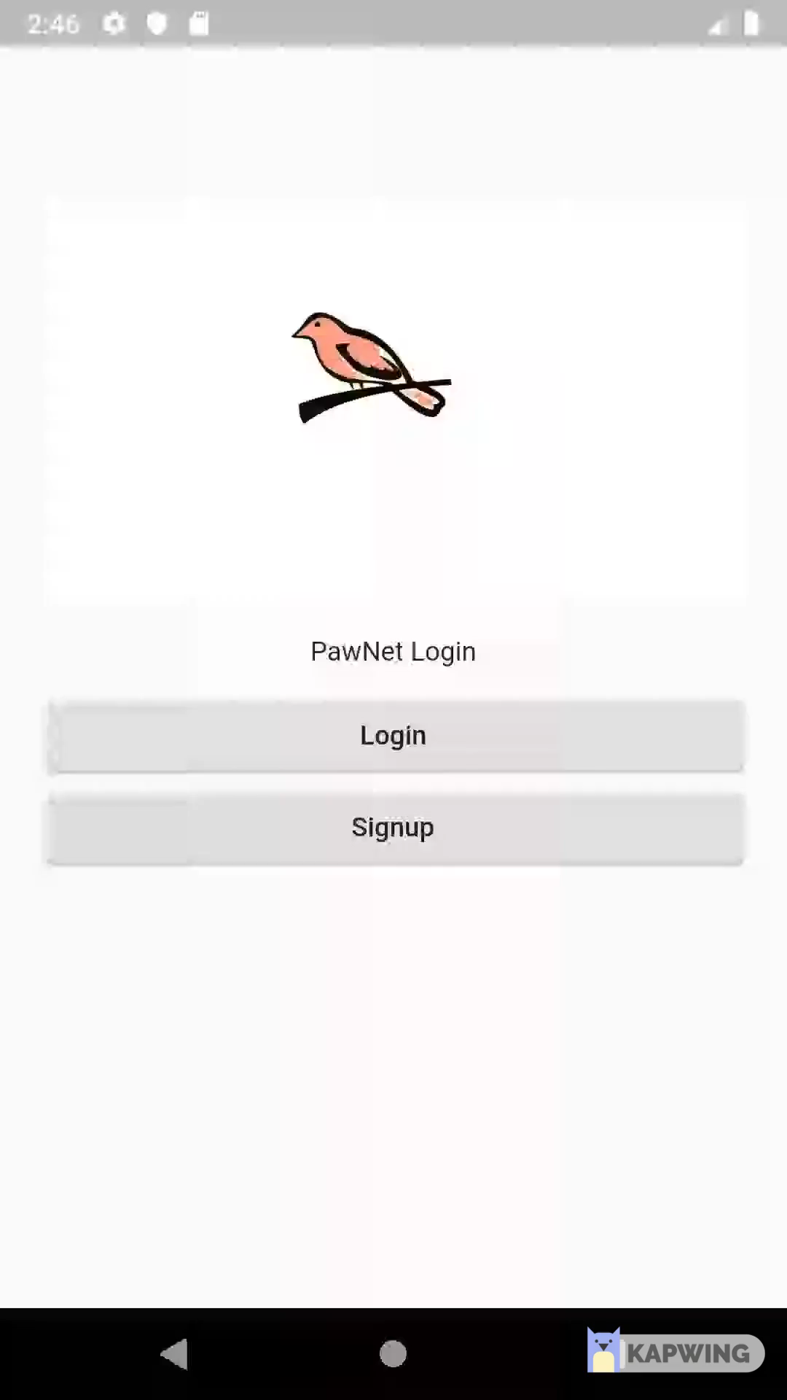
Demo!

Slide 8
From CI-102 to CI-103
Teamwork
MoSCoW – Relative important of user stories
Design specifications should be determined by environment and language
10 week schedule ~4 hours a week

Slide 9
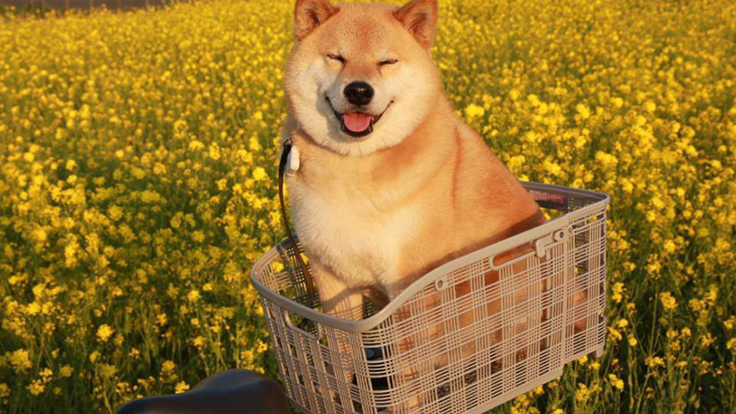
Thank you!
Any Questions?

